Slide 1
Developments in Banking Research & Areas for Further Study
Philip Molyneux
Dean of the College of Business Administration
University of Sharjah
PO Box 27272
Sharjah
United Arab Emirates (UAE)
e-mail: pmolyneux@sharjah.ac.ae
This presentation is mainly based on: Molyneux, P (2018) Developments in Banking Research and Areas for Future Study, International Journal of the Economics of Business,
25th Anniversary Issue: Perspectives on the Economics of Business, 25, 1, 167-179

Slide 2

Presentation Plan
Trends in Banking
Recent research and areas for further study:
capital and liquidity
systemic risk
corporate governance
consumer protection
financial inclusion
size and diversification
impact of government intervention and unconventional monetary policy
Conclusion

Slide 3


Slide 4
Banks Stock prices and CDS premia
Bank for International Settlements (2018) Structural changes in banking after the crisis, Report prepared by a Working Group established by the Committee on the Global Financial System (CGFS), No.60, Basel: Bank for International Settlements.

Slide 5
Growth, Credit and Bond Yields
Bank for International Settlements (2018) Structural changes in banking after the crisis, Report prepared by a Working Group established by the Committee on the Global Financial System (CGFS), No.60, Basel: Bank for International Settlements.

Slide 6
Banking System Size
Bank for International Settlements (2018) Structural changes in banking after the crisis, Report prepared by a Working Group established by the Committee on the Global Financial System (CGFS), No.60, Basel: Bank for International Settlements.

Slide 7
Market structure
Bank for International Settlements (2018) Structural changes in banking after the crisis, Report prepared by a Working Group established by the Committee on the Global Financial System (CGFS), No.60, Basel: Bank for International Settlements.

Slide 8
Business models
Bank for International Settlements (2018) Structural changes in banking after the crisis, Report prepared by a Working Group established by the Committee on the Global Financial System (CGFS), No.60, Basel: Bank for International Settlements.

Slide 9
Retrenchment
Emter, L., Schmitz, M., Tirpák, M (2018) Cross-border banking in the EU since the crisis: what is driving the great retrenchment? European Central Bank Working Paper No 2130, February, Frankfurt: European Central Bank.

Slide 10
Bank assets
Bank for International Settlements (2018) Structural changes in banking after the crisis, Report prepared by a Working Group established by the Committee on the Global Financial System (CGFS), No.60, Basel: Bank for International Settlements.

Slide 11
Bank loans and NPLs
Bank for International Settlements (2018) Structural changes in banking after the crisis, Report prepared by a Working Group established by the Committee on the Global Financial System (CGFS), No.60, Basel: Bank for International Settlements.

Slide 12
Funding structures
Bank for International Settlements (2018) Structural changes in banking after the crisis, Report prepared by a Working Group established by the Committee on the Global Financial System (CGFS), No.60, Basel: Bank for International Settlements.

Slide 13
Bank capitalization
Bank for International Settlements (2018) Structural changes in banking after the crisis, Report prepared by a Working Group established by the Committee on the Global Financial System (CGFS), No.60, Basel: Bank for International Settlements.

Slide 14
Prudential regulation and bank levies
Emter, L., Schmitz, M., Tirpák, M (2018) Cross-border banking in the EU since the crisis: what is driving the great retrenchment? European Central Bank Working Paper No 2130, February, Frankfurt: European Central Bank.

Slide 15
Bank profits
Bank for International Settlements (2018) Structural changes in banking after the crisis, Report prepared by a Working Group established by the Committee on the Global Financial System (CGFS), No.60, Basel: Bank for International Settlements.

Slide 16
Bank revenues
Bank for International Settlements (2018) Structural changes in banking after the crisis, Report prepared by a Working Group established by the Committee on the Global Financial System (CGFS), No.60, Basel: Bank for International Settlements.

Slide 17
Bank costs
Bank for International Settlements (2018) Structural changes in banking after the crisis, Report prepared by a Working Group established by the Committee on the Global Financial System (CGFS), No.60, Basel: Bank for International Settlements.

Slide 18
Summary of key trends
Market structure – banking assets, branches, number of banks have generally fallen particularly more in systems hit hardest by the crisis. Concentration has also generally increased
Regulatory buffers, business models and international activities – capital and liquidity has increased, business models have moved away from trading and more complex models to more traditional retail funded commercial banking. European banks have reduced their international exposures whereas banks from EMEs have increased their international presence
Performance - has fallen post crisis, in part because of lower leverage and general de-risking. This is most noticeable in Europe but also in some EMEs more recently due to a slowdown in growth and deterioration in loan quality
All has implications for bankers, policymakers and researchers in the banking field

Slide 19

Recent banking research and areas for further study:
Capital and liquidity
Systemic risk
Corporate governance
Consumer protection
Financial inclusion
Size and diversification
Impact of government intervention and unconventional monetary policy

Slide 20

Capital
The role of capital in regulating banks has been extensively studied, see for instance Demirgüç-Kunt et al (2013) for an assessment of the role of capital over the crisis
The level of bank equity (the highest quality type of capital) has largely been indicated as having a negative link with risk (Abedifar et al., 2013; Delis and Staikouras, 2011)
There is strong evidence that more capital reduces the probability of bank failure (Berger and Bouwman, 2013). Demirgüç-Kunt et al (2013) and Beltratti and Stulz (2012)

Slide 21
Capital
Capital buffers failed to prevent collapse during the GFC - underlining the importance of understanding capital behaviour.
Empirical work has focused on the determinants of target capital ratios (Gropp and Heider, 2010) and adjustment speeds (Öztekin and Flannery 2012).
Capital adjustment speeds tend to vary country by country and are faster in markets with tough regulations
De Jonghe and Öztekin (2015) - banks deleverage mainly by growing equity and increase leverage via reduced earnings retention and asset expansion.
Types of capital and risk features
Capital regulations and bank behaviour

Slide 22
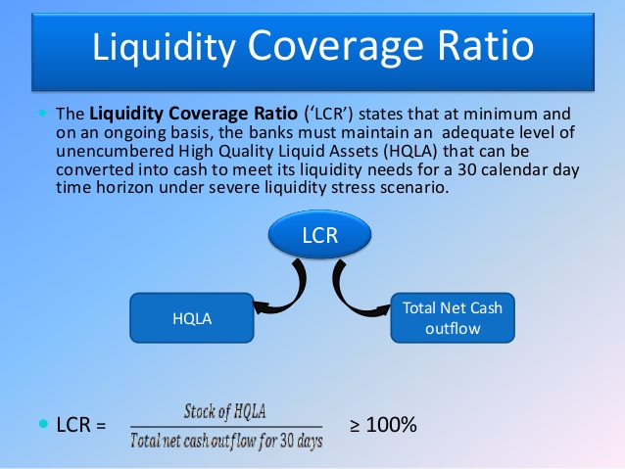
Liquidity
There has been quite an extensive theoretical literature looking to model liquidity issues (Adrian and Boyarchenko, 2017).
There is also an established body of work examining the determinants of bank liquidity, more recent work by Berger and Bouwman (2013) and Berger et al (2016) has focused on a bank’s ability to create liquidity.
Probably more analysis needs to be undertaken looking at the links between capital and liquidity.
Not much work has been done examining bank liquidity shocks and the impact on other banks or the economy overall.
Maybe banks have target liquidity ratios?

Slide 23
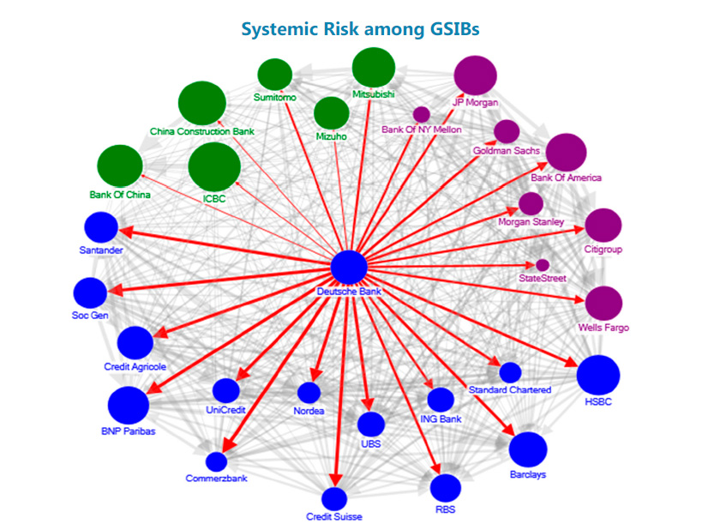
Systemic risk
New ways to measure systemic risk.
Conditional Value at Risk, CoVaR, by Adrian and Brunnermeier (2016)
SRISK by Brownlees and Engle (2017)
Others by Allen et al (2012) and Giglio et al. (2016)
Increasingly bank researchers use systemic risk variables and plug them into models that seek to analyze other phenomena (or to put another way, they control for systemic risk in their estimations).

Slide 24
Systemic risk
A major issue of the ‘new’ measures relates to the reliability / consistency of these measures
If they yield different forecasts of systemic risk – can they be really relied upon to predict future problems?
Maybe an index of systemic risk can be constructed from a combination of these indicators which may provide improved forecasting capability.
Possibly these can be complemented with network measures of interconnectedness?

Slide 25

Corporate governance
Mis-aligned managerial incentives in the financial sector, including excessive compensation practices are viewed by many as a key contributor to the crisis (Bebchuck et al., 2010).
Evidence before and during the crisis does find that bank CEOs who followed strategies more aligned to shareholder wealth creation did appear to fare worse when the crisis hit (Fahlenbrach and Stulz, 2011; Mehran et al., 2012).
Banks that took on greater risk led to more volatility in earnings but not necessarily higher performance (DeYoung et al., 2013; Ellul and Yerramilli, 2013).

Slide 26
Corporate governance
Regulations have been introduced to limit compensation excesses in the financial sector. Probably the toughest rules are those introduced in Europe under the Fourth Capital Requirement Directive (2013) - that the variable part of total compensation cannot exceed 100% of the fixed component
UK introduced a Remuneration Code in 2009 (FSA, 2009); the main element here was to force executives to defer a larger proportion of their bonuses – at least 50% of their bonus must be deferred for three years
The Dodd Frank Wall Street Reform and Consumer Protection Act (2010) in the U.S introduced an advisory vote on executive compensation – ‘Say-on-Pay’ (SOP).

Slide 27
Corporate governance
Kleymenova and Tuna (2016) look at the influence of the UK and EU regulations and find that the market reacted positively to the Remuneration Code but negatively to the EU bonus cap. UK banks also deferred more bonuses and reduced risks – although executive compensation became more complex.
Evidence on Europe is further confirmed by Díaz et al. (2017), who also find that the EU bonus cap legislation was perceived negatively by investors.

Slide 28
Corporate governance
Another area that has interested bank researchers relates to the monitoring capabilities of boards and in particular their characteristics – such as board size, the proportion of independent directors, director experience and gender.
There is evidence in banking that board size is positively linked to performance (Andrés and Vallelado, 2008; Adams and Mehran, 2012) and that banks with more independent directors incurred bigger losses during the financial crisis (Adams, 2012; Erkens et al., 2012).
Palvia et al (2015) find that U.S banks with female CEOs hold more conservative levels of capital after controlling for the bank’s asset risk and other features. Berger et al. (2014) study German savings banks and find that those with a higher proportion of female board members tended to be more risk

Slide 29
Corporate governance
There is substantial interest in an array of bank governance issues and the work is primarily driven by access to micro-data on board characteristics
Possibly more work is needed looking at governance attributes in different size and types of banks, and how this links through to various types of risks (one is stuck just looking at the big banks if one needs market-based risk data)
There are opportunities for more work examining bank boards and political and other firm linkages, and also in the related area of ownership structure / concentration and different types of risk-taking

Slide 30

Consumer protection
In addition to governance issues, there is also growing interest on how the legal environment influences bank behaviour
Dodd Frank Act (2010) set up the Consumer Financial Protection Bureau in 2010 to strengthen consumer protection in the US financial sector. Similar moves have also been made in Europe
The growing interest in this area is very much related to concern that some banks mis-sell products and services to their clients or engage in other bad practice that takes advantage of uninformed customers
Key cases include Wells Fargo’s fraudulent account opening (1.4 million cases), the mis-selling of payment protection insurance (PPI) in the UK and other retail investment products elsewhere in the EU.

Slide 31
Consumer protection
Wehinger (2012) points out that financial consumer protection has not received appropriate attention from regulators, and that it is as important as enhancing efficiency and competition.
Pasiouras (2017) uses an extensive cross-country sample from the World Bank and finds that consumer protection laws tend to reduce the cost of intermediation for banks located in developed economies. In contrast, in developing countries such legislation tends to increase intermediation costs.
Opportunities for using this and other data to examine the links between consumer protection and a host of banking issues (risk, competition and son)

Slide 32

Bank size and diversification
Post-crisis, the costs associated with ‘Too-Big-To-Fail (TBTF) bailouts heightened the policy debate concerning the role and benefits of bank size and the influence of public safety net subsidies that accrue with scale ; (DeYoung and Jiang, 2013; Inanoglu et al. 2016)
The role of large banks and recent regulatory proposals have directed renewed attention to the issue of economies of scale in banking (Davies and Tracey, 2014; DeYoung and Jiang, 2013; Wheelock and Wilson, 2012; Hughes and Mester, 2013, 2015; Beccalli et al, 2015)
There is growing evidence that scale economies are important for big banks.

Slide 33
Bank size and diversification
In addition to economies of scale, banks’ business models have also been driven by economies of scope and deregulation (as highlighted by Gambacorta and van Rixtel, 2013). The trend towards diversification adopted by most large global banks is associated with increased consolidation that results in fewer, much larger and more complex banking conglomerates
Various studies have examined the risk implications of diversification in banking (De Jonghe, 2010; Demirgüç-Kunt and Huizinga, 2010; Brunnermeier, Dong and Palia, 2012; DeYoung and Torna, 2013; Engle et al., 2014; De Jonghe, Diepstraten and Schepens, 2015; Williams, 2016). Such studies show that, combined with traditional intermediation, non-interest activities generally contribute to higher stand alone and systemic risk.

Slide 34
Bank size and diversification
The scope for banks to exploit economies of scale and scope will depend in particular on actual or potential restrictions on size imposed by other regulations, such as the leverage rule in Basel III.
Looking at the impact of this type of regulation on scale and scope economies (as well as other bank efficiencies) would be an interesting avenue of research
Also more needs to be done linking traditional cost / production estimates of efficiency with market-based indicators. Are default probabilities (for instance) linked to productive efficiency (however measured)?

Slide 35
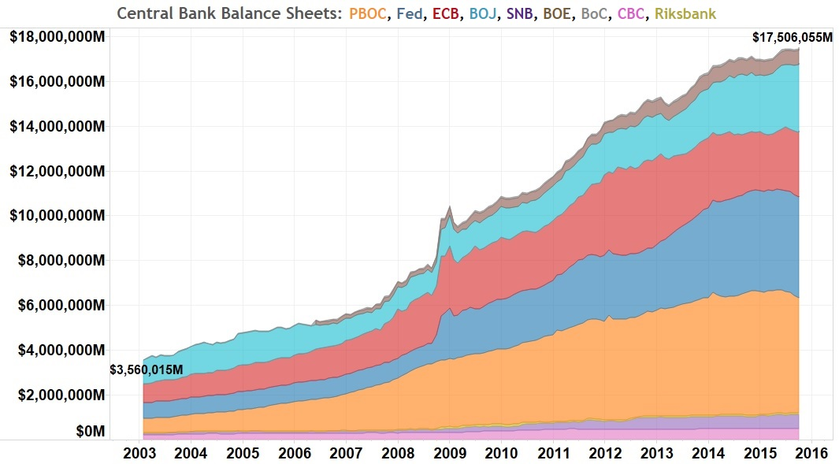
Government intervention and monetary policy
Moves by governments to intervene in their banking sectors to bailout major institutions has spawned a broad literature
Aït-Sahalia et al (2012) show that policy interventions in the U.S, Euro area, UK and Japan were generally associated with a reduction in interbank risk premia
Berger et al. (2017) highlights an increase in moral hazard incentives for banks receiving funding from the U.S TARP
Fiordelisi and Ricci (2016) look at the stock price of G-SIBs and find that monetary policy interventions (whether restrictive or expansionary) have a positive impact on returns

Slide 36
Government intervention and monetary policy
Many central banks implemented a range of unconventional monetary policies (UMP) including Large Scale Asset Purchases (LSAPs), in the form of Quantitative Easing (QE)
UMP took a step further from 2012 onwards when several countries / regions (Denmark, the Euro Area, Hungary, Norway, Sweden, Switzerland and Japan) implemented negative interest rates policy (NIRP)
Heider et al. (2017) find that when policy rates remain positive, deposit rates closely track official rates. However, when policy rates turn negative, banks are reluctant to reduce deposit rates fearing a loss of their funding base.

Slide 37
Government intervention and monetary policy
Claessens et al (2017) finds that in environments with persistently low interest rates both margins and bank profits are depressed
Ball et al. (2016) argue that policy rate cuts below zero are generally transmitted to bank lending rates, although sluggishly. There is no clear relationship between NIRP and bank credit expansion
Arteta et al. (2016) suggest that lending rates generally decline under NIRP, particularly in countries with greater bank competition, but pass-through is only partial

Slide 38
Government intervention and monetary policy
Bräuning and Wu (2017) suggest that negative rate policy reduces loan rates and boosts lending to businesses and households
Demiralp et al. (2017) also find that banks increase lending as a reaction to NIRP
There are substantial opportunities to look at how these UMPs impact banks in a wide array of areas – these issues can easily be linked to other areas discussed in this presentation

Slide 39
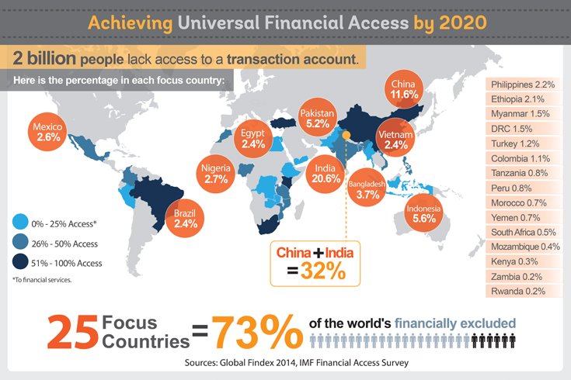
Financial inclusion
Another topic that has moved up the global reform agenda relates to financial inclusion (FI) given its critical role in reducing poverty and boosting shared prosperity (World Bank, 2014; Demirgüç-Kunt and Klapper, 2013)
Access to finance provides individuals with resources to meet their financial needs, such as saving for retirement, investing in education, and purchasing a house.
The opposite, namely financial exclusion, can exacerbate economic disadvantage that may lead to social exclusion. Globally there are around 2 billion working age individuals without access to basic financial services.

Slide 40
Financial inclusion
Measuring financial inclusion is an important topic.
The IMF has built the Financial Access Survey database (FAS) - more than 150 series relating to FI for up to 189 economies spanning 2004-15. Information is obtained from banks, microfinance institutions and other financial firms so can be considered supply-side information on FI.
World Bank has built the Global Financial Inclusion Database (FINDEX) which provides 100 indicators (shown by gender, income, and age) of FI for more than 140 countries most recently for 2014 – this information is obtained from individual survey data so is demand-side based.

Slide 41
Financial inclusion
Several studies use these two databases to examine financial inclusion
Beck and Demirgüç-Kunt (2008), Demirgüç-Kunt and Klapper (2013) and Naceur et al (2015). These generally tend to find that those most likely to be excluded tend to be poor, have low levels of education and are more likely to be women.
Other studies use indexes of inclusion to take account of its multi-dimensional nature (Cáamara and Tuesta; 2014)
There are significant research opportunities to use the aforementioned datasets to examine a wide range of cross-country banking issues.

Slide 42
Conclusion
Here we provide a non-exhaustive review of contemporary empirical research in the banking field
Much has happened since the 2007-08 crisis and there has been an explosion of work on banking related issues as the subject hit the top of the global policy and academic agenda.
After all, the crisis nearly resulted in the collapse of major Western economies, massive taxpayer bailouts, and pushed many economies into recession that still pertains even after a decade.
Banks are still struggling with historically low levels of profits (in Europe at least) and have had to adopt a slew of regulations constraining their activities and limiting their risk-taking capabilities
This presentation summarize the main areas of interest covering recent work on: capital and liquidity; systemic risk; corporate governance; consumer protection, financial inclusion; size and diversification; and the impact of government intervention and unconventional monetary policy
In the discussion we also suggest areas for potential future research
There is much to write about!

Slide 43
References
Abedifar, Pejman. Molyneux, Philip. Tarazi, Amine. 2013. Risk in Islamic Banking. Review of Finance 17(6): 2035–2096.
Adams, Renée Birgit. 2012. Governance and the Financial Crisis. International Review of Finance 12 (1): 7–38.
Adams, Renée Birgit. Mehran, Hamid. 2012. Bank Board Structure and Performance: Evidence for Large Bank Holding Companies. Journal of Financial Intermediation 21 (2): 243–267.
Adrian, Tobias. Brunnermeier, Markus K. 2016. “Co Va R”. American Economic Review 106 (7): 1705-1741.
Adrian, Tobias., Boyarchenko, Nina. 2017. Liquidity Policies and Systemic Risk, Journal of Financial Intermediation (forthcoming)
Aït-Sahalia, Yacine. Andritzky, Jochen. Jobst, Andreas. Nowak, Slywia. Tamirisa, Natalia. 2012. Market Response to Policy Initiatives During the Global Financial Crisis. Journal of International Economics 87 (1): 162-177.
Allen, Linda. Bali, Turan G. Tang, Yi. 2012. Does Systemic Risk in the Financial Sector Predict Future Economic Downturns? The Review of Financial Studies 25(10): 3000–3036.
Andrés, Pablo de. Vallelado, Eleuterio. 2008. Corporate Governance in Banking: The Role of the Board of Directors. Journal of Banking & Finance 32 (12): 2570–2580.
Arteta, Carlos. Kose, M. Ayhan. Stocker, Marc. Taskin, Temel. 2016. Negative Interest Rate Policies: Sources and Implications. World Bank Policy Research Paper 7791, August. Washington DC: World Bank.
Ball, Laurence. Gagnon, Joseph. Honohan, Patrick. Krogstrup, Signe. 2016. What Else can Central Banks Do? Geneva Reports on the World Economy 18, The International Center for Monetary and Banking Studies (ICMB) and the Centre for Economic Policy Research (CEPR). ICBM: Zurich and CEPR: London.
Bank for International Settlements (2018) Structural changes in banking after the crisis, Report prepared by a Working Group established by the Committee on the Global Financial System (CGFS), No.60, Basel: Bank for International Settlements.
Bebchuk, Lucian A. Cohen, Alma. Spamann, Holger. 2010. The Wages of Failure: Executive Compensation at Bear Stearns and Lehman 2000-2008. Yale Journal on Regulation 27 (2), 257–282.
Beccalli, Elena. Anolli, Mario. Borello, Giuliana. 2015. Are European Banks Too Big? Evidence on Economies of Scale. Journal of Banking & Finance 58 (10): 232-246
Beck, Thorsten. Demirgüç-Kunt, Asli. Peria, Maria Soledad Martinez. 2008. Banking Services for Everyone? Barriers to Bank Access and Use around the World. World Bank Economic Review 22 (3): 397 - 430.
Beltratti, Andrea. Stulz, René M. 2012. The Credit Crisis around the Globe: Why did some Banks Perform Better? Journal of Financial Economics 105(1): 1–17.
Berger, Allen N. Bouwman, Christa H S. Kick, Thomas. Schaeck, Klaus. 2016. Bank Liquidity Creation Following Regulatory Interventions and Capital Support. Journal of Financial Intermediation 26 (April): 115-141.

Slide 44
References
Berger, Allen. N. Makaew, Tanakorn. Roman, Raluca A. 2017. Do Business Borrowers Benefit from Bank Bailouts? The Effects of TARP on Loan Contract Terms, Available at https://papers.ssrn.com/sol3/papers.cfm?abstract_id=2736440
Berger, Allen N., Kick, Thomas., Schaeck, Klaus, 2014, Executive board composition and bank risk taking. Journal of Corporate Finance, 28, 48-65
Berger, Allen N. Bouwman, Christa H S. 2013. Bank Liquidity Creation. The Review of Financial Studies 22 (9): 3779-3837.
Bräuning, Falk. Wu, Botao. 2017. ECB Monetary policy transmission during normal and negative interest rate periods. doi: http://dx.doi.org/10.2139/ssrn.2940553
Brownlees, Christian. Engle, Robert F. 2017. SRISK: A Conditional Capital Shortfall Measure of Systemic Risk, The Review of Financial Studies 30 (1): 48–79.
Brunnermeier, Markus K., Dong, G Nathan. Palia, Darius. 2012. Banks Non-interest Income and Systemic Risk. American Finance Association 2012 Chicago Meeting Paper
https://papers.ssrn.com/sol3/papers.cfm?abstract_id=1786738
Cámara, Noelia. Tuesta, David. 2014. Measuring Financial Inclusion: A Multidimensional Index, BBVA Working Paper 14/26 , September, Madrid: BBVA
Claessens, Stijn. Coleman, Nicholas S. Donnelly, Michael. 2017. Low-for-long Interest Rates and Banks’ Interest Margin and Profitability: Cross-country Evidence. Federal Reserve Board International Finance Discussion Paper 1197, Washington DC: Federal Reserve Available at SSRN: https://ssrn.com/abstract=2923972
Davies, Richard. Tracey, Belinda. 2014, Too Big to be Efficient? The Impact of Implicit Funding Subsidies on Scale Economies in Banking, Journal of Money, Credit and Banking 46 (1): 219-253.
De Jonghe, Olivier. 2010. Back to the Basics in Banking? A Micro-analysis of Banking System Stability, Journal of Financial Intermediation 19 (3): 387-417.
De Jonghe, Olivier. Öztekin, Özde. 2015. Bank Capital Management: International Evidence. Journal of Financial Intermediation 24 (2): 154-177.
De Jonghe, Olivier. Diepstraten, Maaike. Schepens, Glenn. 2015. Banks’ Size, Scope and Systemic Risk: What Role for Conflicts of Interest? Journal of Banking & Finance 61(Supplement 1, December): S3-S13.
Delis, Manthos D. Staikouras, Panagiotis K. 2011. Supervisory Effectiveness and Bank Risk. Review of Finance 15(3): 511–543.
Demiralp, Selva. Eisenschmidt, Jens. Vlassopoulos, Thomas. 2017. Negative Interest Rates, Excess Liquidity and Bank Business Models: Banks’ Reaction to Unconventional Monetary Policy in the Euro Area. Koç University-TUSIAD Economic Research Forum Working Papers 1708, Istanbul, Koc University-TUSIAD Economic Research Forum.
Demirgüç-Kunt, Asli. Detragiache, Enrica. Merrouche, Ouarda. 2013. Bank Capital: Lessons from the Financial Crisis. Journal of Money, Credit and Banking 45(6): 1147–1164.

Slide 45
References
Demirgüç-Kunt, Asli. Huizinga, Harry. 2010. Bank Activity and Funding Strategies: The Impact on Risk and Returns. Journal of Financial Economics 98 (3): 626-650.
Demirgüç-Kunt, Asli and Klapper, Leora. 2013. Measuring Financial Inclusion: Explaining Variation in Use of Financial Services across and within Countries, Brookings Papers on Economic Activity, Spring. 279-340. Washingtom DC: Brookings Institution Press.
DeYoung, Robert. Peng, Emma Y. Yan, Meng. 2013. Executive Compensation and Business Policy Choices at U.S. Commercial Banks. Journal of Financial and Quantitative Analysis 48 (1): 165-196.
DeYoung, Robert. Torna, Gökhan. 2013. Nontraditional Banking Activities and Bank Failures during the Financial Crisis. Journal of Financial Intermediation 22 (3): 397-421
DeYoung, R. Jiang, Chao. 2013. Economies of Scale and the Economic Role of Banks. Working paper. Presented at the University of Limoges Limoges, France, May 27.
Díaz Díaz, Belen. García-Ramos, Rebeca. García Olalla, Myriam. 2017. Shareholder Wealth Responses to European Legislation on Bank Executive Compensation. Journal of Economic Policy Reform 20(3): 1–21.
Ellul, Andrew. Yerramilli, Vijay. 2013. Stronger Risk Controls, Lower Risk: Evidence from US Bank Holding Companies. The Journal of Finance 68(5): 1575–1803.
Emter, L., Schmitz, M., Tirpák, M (2018) Cross-border banking in the EU since the crisis: what is driving the great retrenchment? European Central Bank Working Paper No 2130, February, Frankfurt: European Central Bank.
Engle, Robert. Moshirian, Fariborz. Sahgal, Sidharth. Zhang, Bohui. 2014. Non-interest Income and Systemic Risk: The Role of Concentration, Centre for International Finance and Regulation (CIFR) Research Working Paper 015/2014 (April).
Erkens, David H. Hung, Mingyi. Matos, Pedro. 2012. Corporate Governance in the 2007–2008 Financial Crisis: Evidence from Financial Institutions Worldwide. Journal of Corporate Finance 18 (2): 389–411.
Fahlenbrach, Rüdiger. Stulz, René M. 2011. Bank CEO Incentives and the Credit Crisis. Journal of Financial Economics 99 (1): 11–26.
FSA (2009) Reforming Remuneration Practices in Financial Services, Policy Statement 9/15,
August, London: Financial Services Authority.
Fiordelisi, Franco. Ricci, Ornella. 2016. “Whatever it takes”: An Empirical Assessment of the Value of Policy Actions in Banking, Review of Finance 20 (6): 2321–2347.

Slide 46
References
Gambacorta, Leonardo. van Rixtel, Adrian. 2013. Structural Bank Regulation Initiatives: Approaches and Implications, Bank for International Settlements (BIS) Working Paper 412, April, Basel: BIS.
Giglio, Stefano. Kelly, Bryan. Pruitt, Seth. 2016. Systemic Risk and the Macroeconomy: An Empirical Evaluation. Journal of Financial Economics 119 (3): 457-471.
Gropp, Reint. Heider, Florian. 2010. The Determinants of Bank Capital Structure. Review of Finance 14 (4): 587–622.
Heider, Florian. Saidi, Farzad. Schepens, Glenn. 2017. Life Below Zero: Bank Lending Under Negative Policy Rates. Available at SSRN: https://ssrn.com/abstract=2788204
Hughes, Joseph P. Mester, Loretta J. 2013. Who Said Large Banks Don’t Experience Scale Economies? Evidence from a Risk-Return-Driven Cost Function. Journal of Financial Intermediation 22(4): 559-585.
Hughes, Joseph P. Mester, Loretta J. 2015. Measuring the Performance of Banks: Theory, Practice, Evidence, and some Policy Implications, in The Oxford Handbook of Banking, 2nd Edition, Chapter 10, edited by A.N Berger, P. Molyneux and J. O. S. Wilson, 247-270. Oxford: Oxford University Press.
Inanoglu, Hulusi. Jacobs, Michael. Liu, Junrong. Sickles, Robin C. 2016. Analyzing Bank Efficiency: Are ‘Too-Big-To-Fail’ Banks Efficient? in The Handbook of Post Crisis Financial Modeling, Chapter 5, edited by E. Haven, P. Molyneux, J. O. S. Wilson, S. Fedotov, M.Duygun, 110-146, Frankfurt: Springer International.
Kleymenova, Anya. Tuna, A. Irem. 2016. Regulation of Compensation. Chicago Booth Research Paper 16-07. Available at SSRN: https://ssrn.com/abstract=2755621
Mehran, Hamid. Morrison, Alan. Shapiro, Joel. 2012. Corporate Governance and Banks: What Have We Learned from the Financial Crisis? in The Crisis Aftermath: New Regulatory Paradigms edited by M. Dewatripont and X. Freixas, Chapter 2, 11-44. London: Centre for Economic Policy Research (CEPR).
Naceur, Sami Ben. Barajas, Adolfo. Massara, Alexander. 2015. Can Islamic Banking Increase Financial Inclusion? IMF Working Paper WP/15/31. Washington DC: IMF.
Öztekin, Özde. Flannery, Mark J. 2012. Institutional Determinants of Capital Structure Adjustment Speeds. Journal of Financial Economics 103 (1): 88–112.
Pasiouras, Fotios. 2017. Financial Consumer Protection and the Cost of Financial Intermediation: Evidence from Advanced and Developing Economies. Management Science (forthcoming). Available at https://doi.org/10.1287/mnsc.2016.2585
Palvia, Ajay. Vähämaa, Emilia. Vähämaa, Sami. 2015. Are Female CEOs and Chairwomen More Conservative and Risk Averse? Evidence from the Banking Industry During the Financial Crisis, Journal of Business Ethics 131(3): 577–594.
Wheelock, David C. Wilson, Paul W. 2012. Do Large Banks Have Lower Costs? New Estimates of Returns to Scale for U.S. Banks. Journal of Money, Credit and Banking 44 (1): 172-199.
Wehinger, Gert. 2012. Banking in a Challenging Environment: Business Models, Ethics and Approaches Toward Risks. OECD Journal: Financial Market Trends 2: 79-88.
Williams, Barry. 2016. The Impact of Non-Interest Income on Bank Risk in Australia, Journal of Banking & Finance 73 (December): 16-37.
World Bank, 2014. Global Financial Development Report, Washington DC: World Bank.

